Slide 1
Signals and characteristics
Physical layer is the lowest layer in the OSI reference model. Information can be transmitted or received using cables. The main purpose of the physical layer is to transmit information (data or text or even animated pictures) from a source to a destination. Any form of such information cannot be transmitted as it is, just as in a postal service. Information is transmitted from a source computer to a destination computer in the form of electromagnetic signals using the transmission medium. For example, if you want to transmit a photograph from a source computer to a destination computer, it is first encoded as a stream of bits 0s and 1s. Then this stream is reconverted as energy in the form of electromagnetic signals. Then only these electromagnetic signals can be transmitted over the network, through a transmission medium. The destination computer receives these signals. They are encoded to the original form. As such signals play a very important role in transmitting information. In view of this, we first pay our attention to the study of signals and the terminology used with respect to signals.

Slide 2
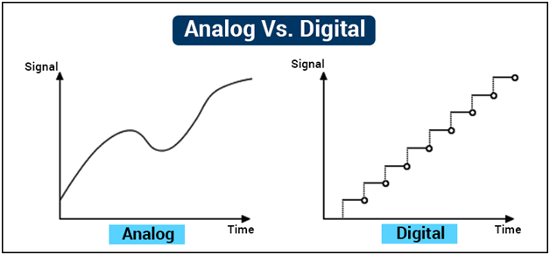
ANALOG AND DIGITAL SIGNALS
There are two types of signals, namely analog (also called continuous) and digital (also called discrete). Analog quantities are used for measurement, whereas digital quantities are used for counting. For example, you can go to a provision shop and ask for 1.25 kg of sugar. But, you cannot ask for 1.25 number of bananas. The first one is a continuous one and the second one is a measurement. Graphs of these two types of signals are shown below.

Slide 3
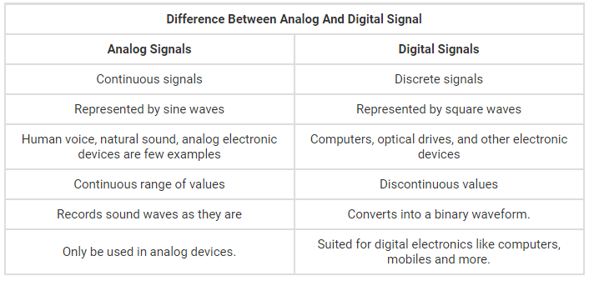

Slide 4
Characteristics of Analog and Digital Signals
Adaptability:-Analog signals use a continuous variety of amplitude values whereas digital signal takes a limited set of distinct values at consistently spaced spots in the time.
Type of Data
Analog signals are continuous in nature, whereas digital signals are discrete.
Type of Waves
Analog signal wave type is sine wave, whereas a digital signal is a square wave.
Medium of Transmission
Analog signal medium of transmission is wire or wireless, whereas a digital signal is a wire.
Type of Values
Analog signal value type if positive as well as negative, whereas a digital signal is positive.
Security
The security of an analog signal is not encrypted, whereas a digital signal is encrypted.
Bandwidth
The analog signal bandwidth is low, whereas the digital signal is high.
Hardware
Analog signal hardware is not elastic, whereas digital is elastic in execution
Data Storage
The data storage of an analog signal is in the wave signal form, whereas digital signal stores the data in the binary bit form.

Slide 5
Portability
Analog signals are portable similar to the thermometer and low cost, whereas digital signals are portable similar to computers and expensive.
Data transmission
In analog, the signal can be deterioration due to noise throughout transmission, whereas digital signal can be noise resistant throughout transmission devoid of any deterioration.
Impedance
The impedance of the analog signal is low, whereas the digital signal is high.
Power Consumption
Analog devices use more power, whereas digital devices use less power.
Data Transmission Rate
The data transmission rate in the analog signal is slow, whereas in the digital signal it is faster.
Examples
The best examples of the analog signal are video, human voice in the air, radio transmission waves or TV
Applications
Analog signals can be utilized in analog devices exclusively, thermometer, whereas digital signals are appropriate for digital electronic devices like computers, PDA, cell phones.

Slide 6
Advantages of Digital Signal Over Analog Signal
There are several advantages using digital signal over an analog signal.
Digital signals are more secure, and they do not get damaged by noise.
These signals use low bandwidth
They allow the signals transmitted over a lengthy distance.
Digital signal has a higher rate transmission
By using these signals, we can translate the messages, audio, video into device language.
Digital signals enable the transmission of multidirectional concurrently.

Slide 7
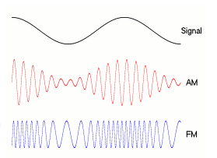
Modulation
Types of modulation
There are many common modulation methods, including the following -- a very incomplete list:
Amplitude modulation (AM), in which the height -- i.e., the strength or intensity -- of the signal carrier is varied to represent the data being added to the signal.
Frequency modulation (FM), in which the frequency of the carrier waveform is varied to reflect the frequency of the data.

Slide 8
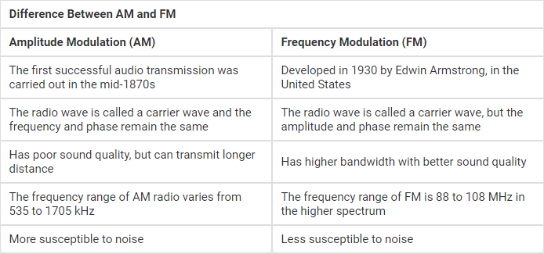
Pros and cons
AM has poorer sound quality compared with FM, but is cheaper and can be transmitted over long distances. It has a lower bandwidth so it can have more stations available in any frequency range.FM is less prone to interference than AM. However, FM signals are impacted by physical barriers. FM has better sound quality due to higher bandwidth.

